Slide 1





Project Progress
A presentation for the NYC DOT Asset Management Unit
Christina CJ
August 19, 2022
Notes:
Hello everyone, hope you are having a good day. My name is christina cruz jimenez and i will be presenting my final project progress report for the NYC DOT asset management unit

Slide 2
Background, Goals, Objectives
Background
NYC DOT has requested the creation of a script
Goal
Create a script in python that sends an automated email when an asset in the list is out of date
Completing all of the codes requirements
Complete the project Early/ On- time
Follow the planned out schedule
Objectives
Objectives
Notes:
Background: The NYC DOT has requested the creation of a script to aid in the automation of sending emails about certain data collected. My mission is to create a smooth functioning code that the NYC DOT’s Asset Management Unit will find useful.
My goal was to create a python script that sends an automated email when an asset in the list is out of date and complete the project in an orgonized and timely manner
My objectives included Completing all of the codes requirements, these code requirements are seen in the process diagram on the next slide, Complete the project Early/ On- time which was accomplished, and Following the planned out schedule which was also accomplished

Slide 3
Process Diagram
Yes
If Empty Say That in The Email
Yes
Is new Excel Sheet Empty?
Send Email
Out of Date
Add Piece of Data to a New Excel Sheet
No
If There is Data Say in The Email
Data(With Dates) is Imported
Code Reads through Excel Sheet Data
Is this the last piece of Data?
Up to Date
No
Continue to Read Through the Data
Notes:
Read slide

Slide 4









Schedule for Workflow diagram
Coding
Testing
Documenting
Coding will be fully completed by August 3rd
Testing/Debugging will be fully completed by August 12th
Documenting will be FULLY completed by August 15th but will be simultaneously with the coding
Notes:
This was the scheduled workflow which was all completed on time. Coding was done august 3rd, testing and debugging on august 12 and completing all documentation by the 15th

Slide 5

Communication Plan
Format &
Channel
Name
Title
Frequency
Notes
Maddalena Romano
Sponsor
Occasional Updates
Progress meetings during zoom and through emails
Prefers you to ask questions as soon as they arise
Notes:
This was my communication plan throughout the project, I contacted Maddalena ROmans who was the sponsor of the project, I sent occasional updates via progress meetings like this one and through email. Maddelena prefers you to ask questions as soon as they arise rather then later so you have time to make any changes

Slide 6
Communication Plan
Type
Method
Frequency
Goal
Owner
Audience
Progress/ Status Report
Powerpoint & Email
Twice, the midway point(Aug 2nd) and the final point(August 19). For email at main milestones
Review project progress, project plan, and discuss any issues
Project Manager
Sponsor & Fellow Colleagues
Notes:
I sent maddalena progress status reports through email and powerpoint. There were two powerpoints made with one being presented now and sent emails about certain issues and about certain milestones, the goal of the powerpoints and emails were to review my progress. I am the owner and project manager of this project and I am presenting it not my fellow colleagues and to my project sponsor

Slide 7
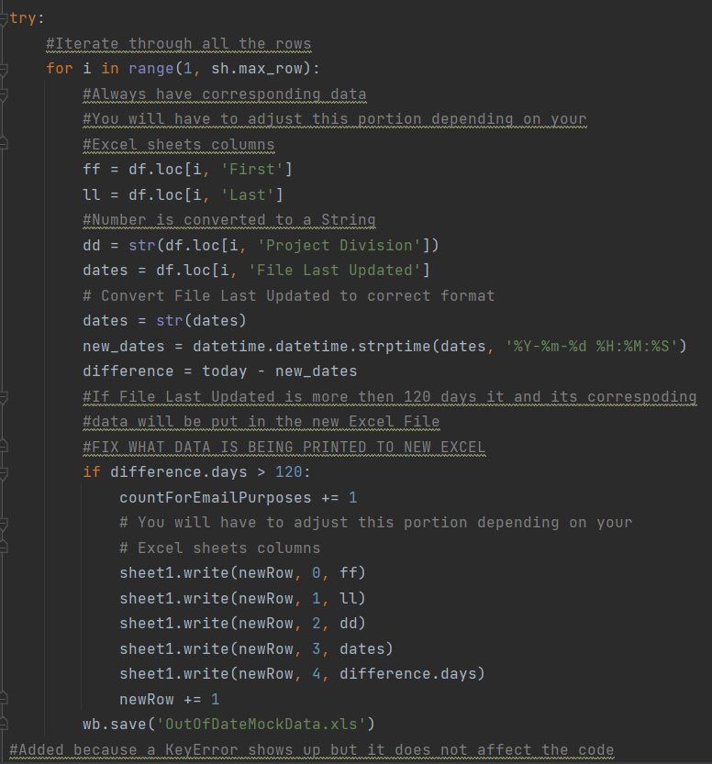
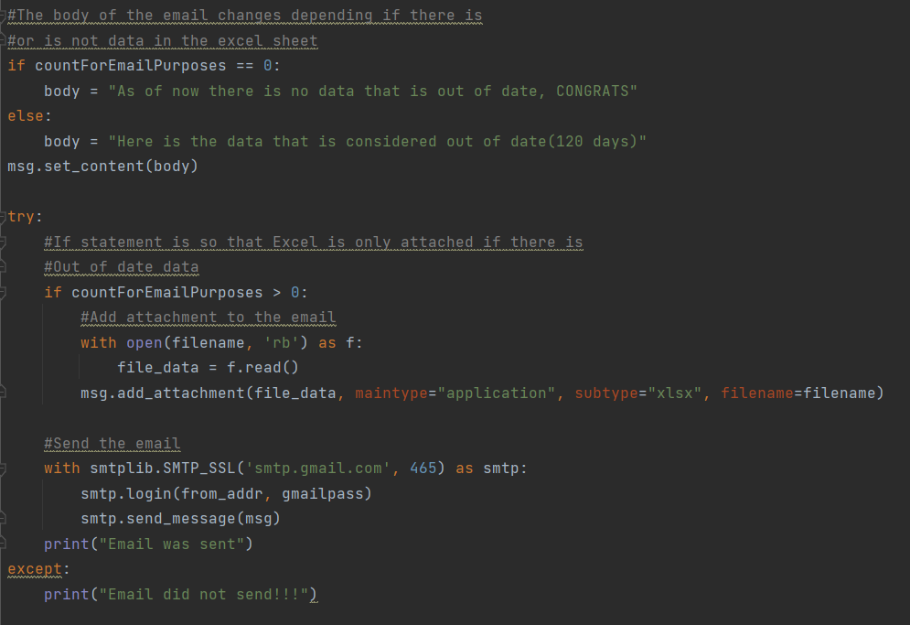
Screenshots
Notes:
Screenshots: The code on the left is for determining if data is outdated and putting that data in an excel sheet. THe right code shows how the email with an excel sheet is sent

Slide 8

Demonstration
Notes:
Demostration: Show code and email, remember to change count

Slide 9
Schedule for next steps
July 28th
½ way point for coding
August 12th
Testing and Debugging Completed
August 17th
Sign off Completed
(Is Accepted)
28
12
17
3
15
19
August 3rd
Coding is Completed
August 15th
Materials Completed
August 19th
Close out Completed
Notes:
This was the schedule of my project with today being August 19th

Slide 10
What Has Been Learned
Online Resources are your friend
Test, test, then test once more
Updates
Github is not so horrible
Learning can be fun
Notes:
Do not be discouraged by having to use online resources, watching yt videos, ext. You are not going to know everything, especially if it is a new language for you. Looking these things up does not make you less competent but rather resourceful.
New stop testing your code. Continuously test your code while you work, especially when you are stuck. Looking at what the code is already doing gives you a better sense of what needs to be done and seeing it over and over again forces you to try and figure out how to improve your work
Keep your boss updated. It leaves less room for then not to like your work at the end. It also gives them a sense of where you are at in the project and lets them know you are hitting all for your scheduled marks
Github is not so bad. Before working here I desperately did not like Github, it was intimidating and confusing. It turned out to be not as horrible when I did not have to submit homework assignments into it. It looks professional and clearly shows the process of my work, I understand why everyone loves it
Learning a new language and jumping into the deep end was a lot more fruitful than anticipated. School has taken a lot of the fun out of being a coder and learning something new but as I used to believe, it is still very enjoyable and not as difficult as you would think.

Slide 11
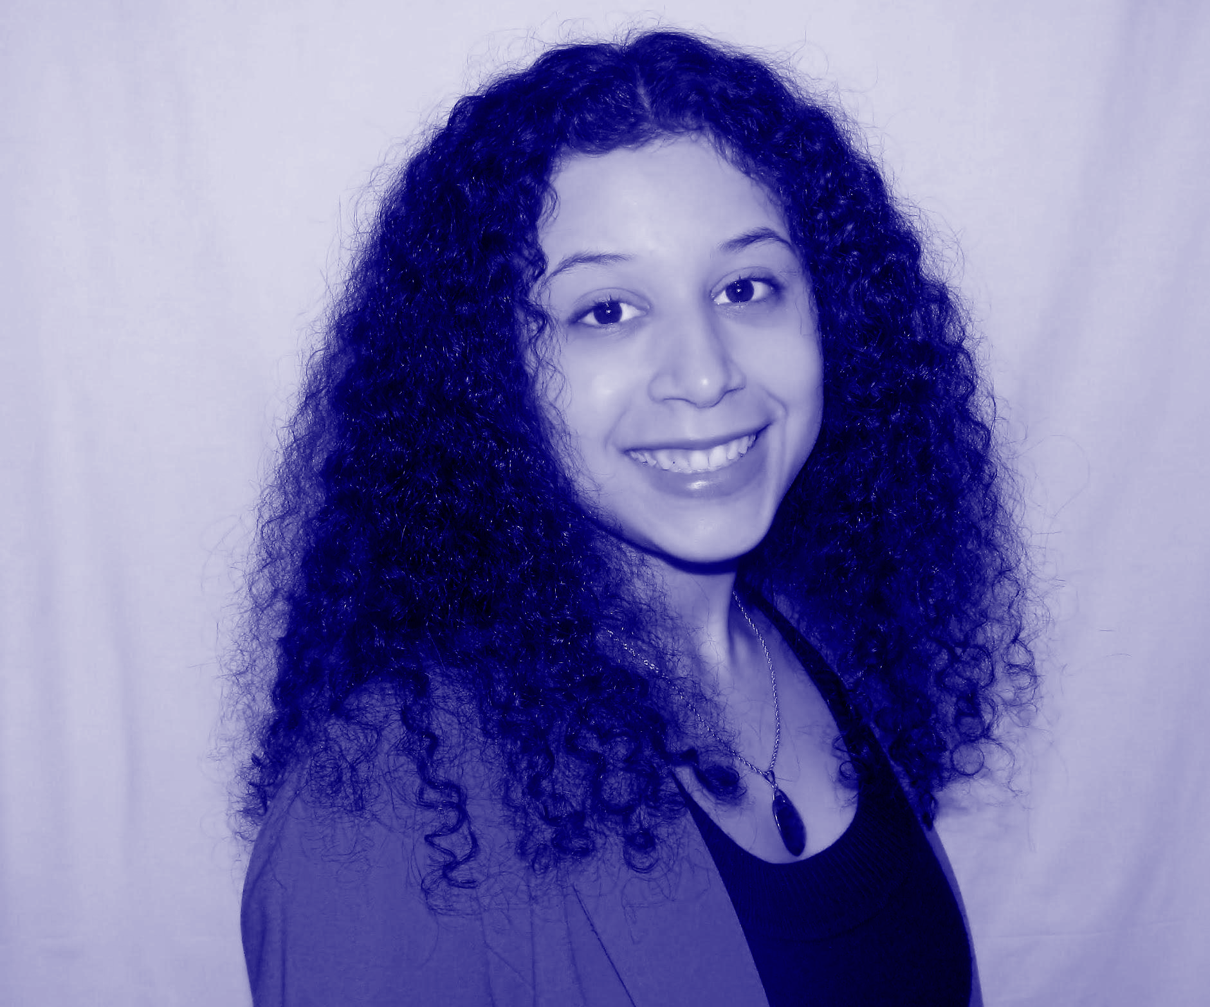
Questions
Thank You!
Christina CJ
https://github.com/cbcj3000/DOT/tree/main
https://www.linkedin.com/in/christina-cj-1671481b3/

